Slide 1
A MINI PROJECT ON
“IOT BASED HOME AUTOMATION”
Under the guidance of By
Dr. Navneet Kumar, Assistant Professor VISHAL KUMAR (2107350200053)
Er. Suneel Kumar, Assistant Professor SHIVAM (2107350200044)
(Department of Electrical Engineering) VIVEK KUMAR (2107350200055)
RAJKIYA ENGINEERING COLLEGE, BIJNOR
Dr. A.P.J. Abdul Kalam Technical University, Lucknow

Slide 2
Introduction:
In this ESP32 project, I have explained how to make an IoT project using ESP RainMaker with Google Assistant & Alexa. With this internet of things project, you can control 8 home appliances with Google Assistant, Alexa, and manual switches. You can also control the relays from Google Home and Amazon Alexa App from anywhere in the world.
And you don’t need any Google Nest or Amazon Echo Dot devices for this voice control home automation project.

Slide 3
With this home automation project, you can control & monitor the real-time feedback of the relays in the Google Home, Amazon Alexa, and ESP RainMaker app from anywhere in the world. If the Wi-Fi is available, the ESP32 will automatically connect with the Wi-Fi.
For this project, I have used all the FREE tools. So if you follow all steps, you can easily make this Smart Home System with Google Assistant and Alexa to control the appliances with voice commands.

Slide 4
Required Components for the ESP32 project
ESP32 Microcontroller
Relay Module 4 channel
Switches
Buttons
LED Lights
Bulb Holders
ESP Rainmaker
ESP Rainmaker User Interface for app.

Slide 5
ESP Rainmaker User Interface for app.
ESP Rainmaker Dashboard for web.
Circuit for ESP32 Control 4 Relays

Slide 6
ESP32 Microcontroller
ESP32 is already integrated antenna and RF, power amplifier, low-noise amplifiers, filters, and power management mode. The entire solution takes up the least amount of printed circuit board area. This board is used with 5 GHz dual-mode Wi-Fi and chips by TSMC 40nm low power technology, power and RF properties best, which is safe, reliable, and scalable to a variety of applications.

Slide 7
2.1 ESP32 Microcontroller
ESP32 is a series of low-cost, low-power system on a chip microcontrollers with integrated Wi-Fi and dual-mode Bluetooth. The ESP32 series employs either a Tensilica Xtensa LX6 microprocessor in both dual-core and single-core variations, Xtensa LX7 dual-core microprocessor or a single-core RISC-V microprocessor and includes built-in antenna switches, RF balun, power amplifier, low-noise receive amplifier, filters, and power-management modules. ESP32 is created and developed by Espressif Systems, a Chinese company based in Shanghai, and is manufactured by TSMC using their 40 nm process.^{[2]} It is a successor to the ESP8266 microcontroller.

Slide 8
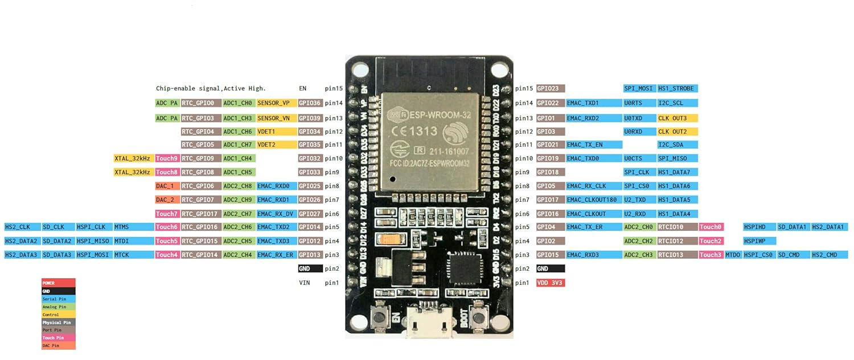
Fig.no 1. ESP32 Microcontroller

Slide 9
2.2 Relay Module 4 channel
This is a 5V 4-Channel Relay interface board, be able to control various appliances and other equipment with large current. It can be controlled directly by Microcontroller (for Arduino, 8051, AVR, PIC, DSP, ARM, ARM, MSP430, TTL logic).
Features:
5V 4-Channel Relay interface board and each one needs 15-20mA Driver Current.
Equipped with high-current relay, AC250V 10A; DC30V 10A.
Standard interface that can be controlled directly by microcontroller (for Arduino, 8051, AVR, PIC, DSP, ARM, ARM, MSP430, TTL logic).
Indication LED’s for Relay output status.

Slide 10
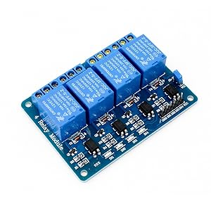
2.2 Relay Module 4 channel

Slide 11
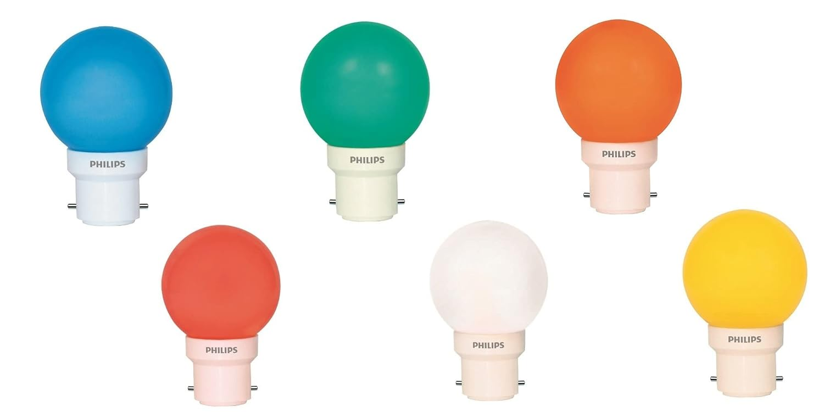
2.3 LED Lights

Slide 12
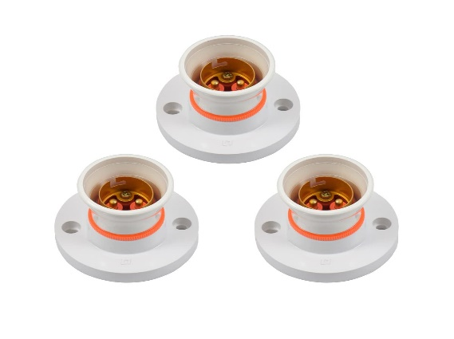
2.4 Bulb Holders

Slide 13
ESP Rainmaker
"ESP RainMaker" is a framework developed by Espressif Systems, the manufacturer of the ESP8266 and ESP32 microcontrollers. ESP RainMaker is designed to simplify the development of Internet of Things (IoT) projects on ESP8266 and ESP32 platforms by providing a set of APIs and tools for device provisioning, control, and monitoring.

Slide 14
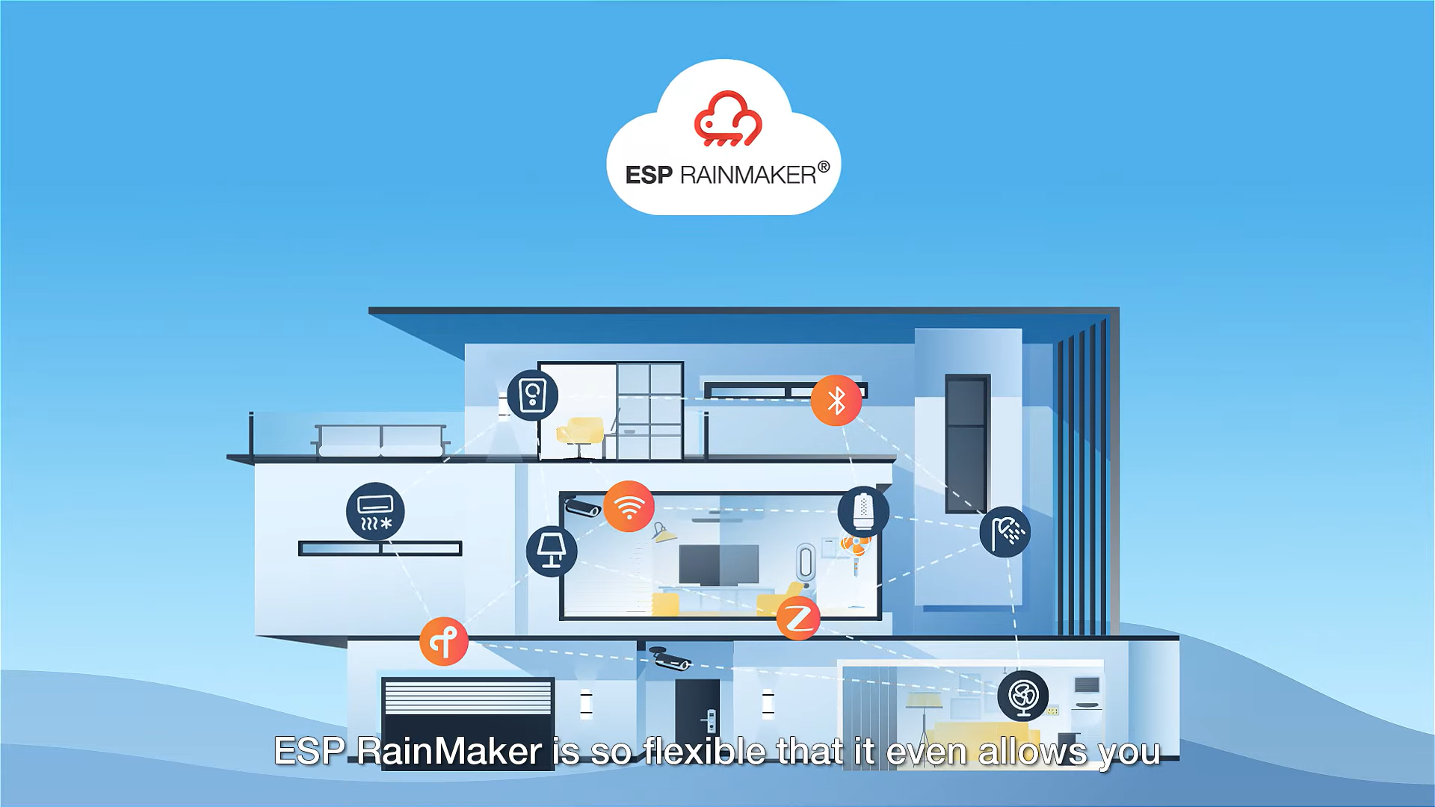
Fig.no 7 ESP Rainmaker

Slide 15
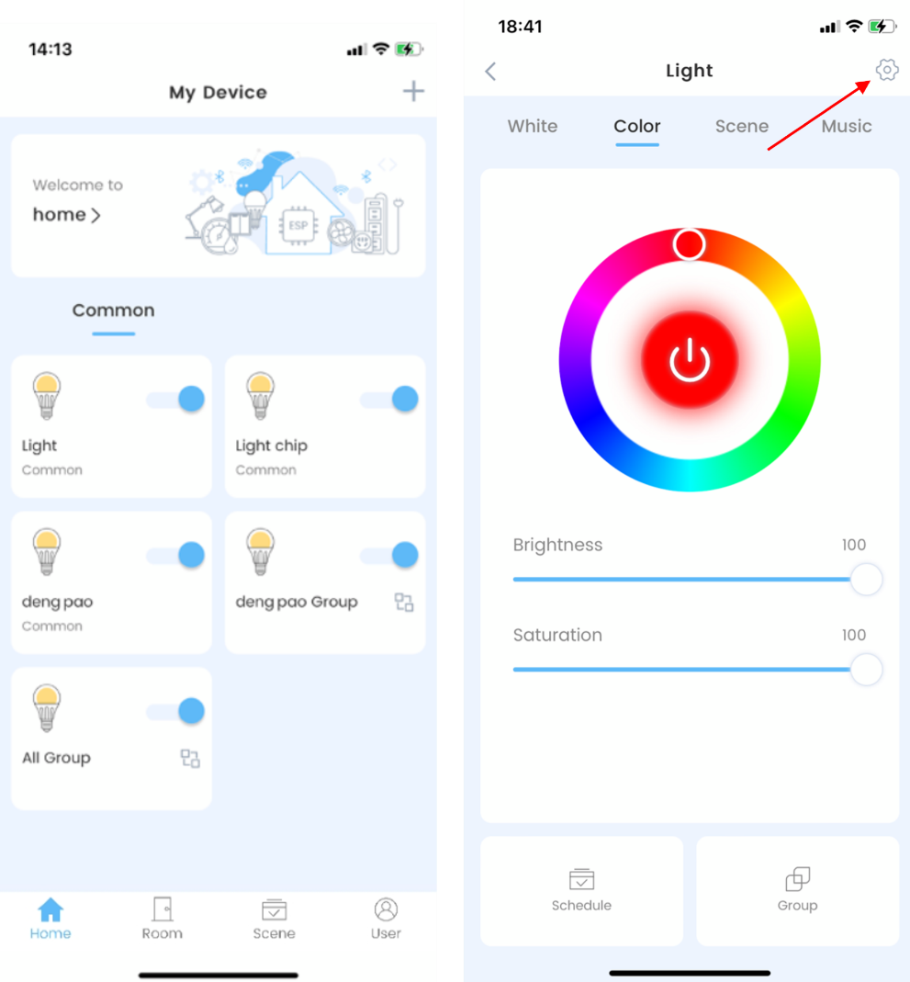
ESP Rainmaker User Interface for app.

Slide 16
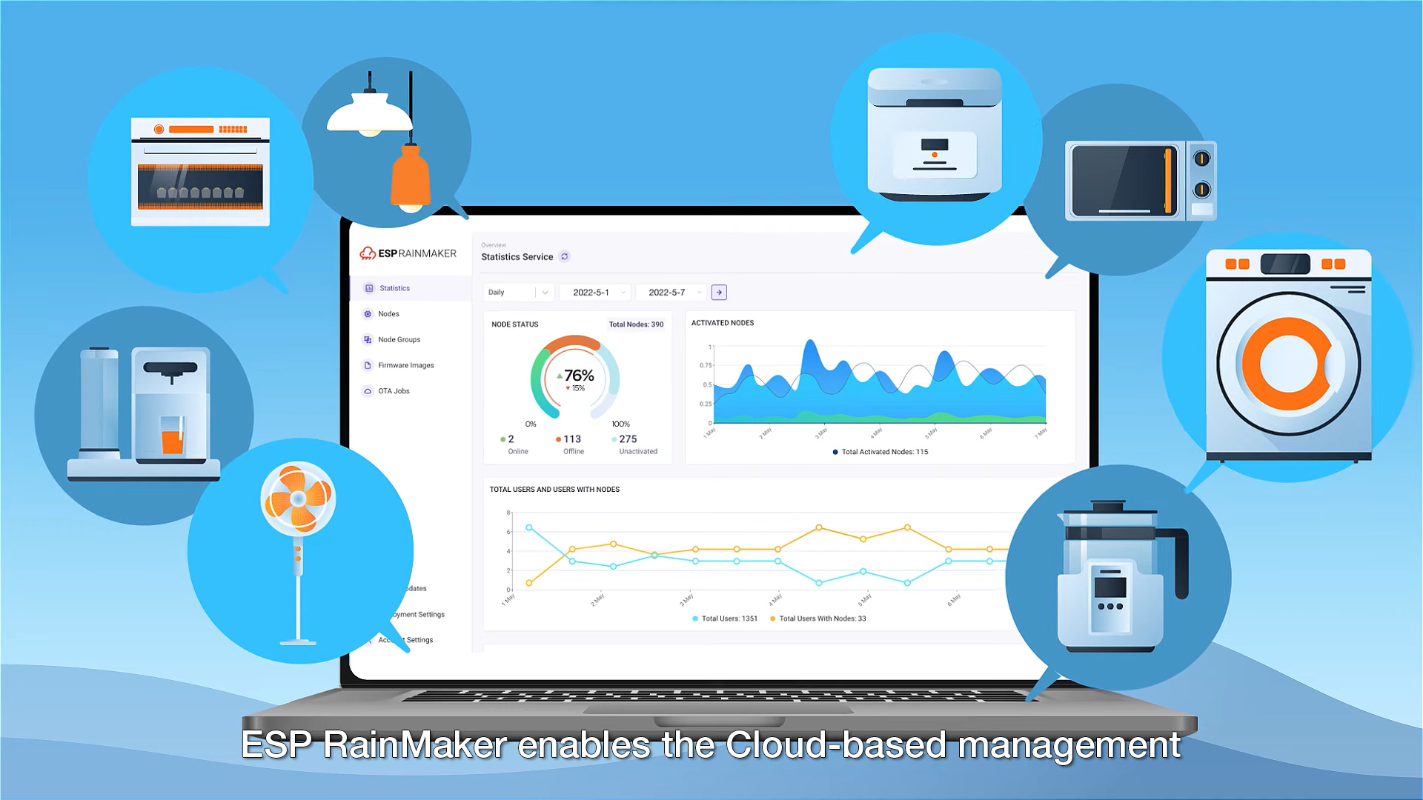
ESP Rainmaker Dashboard for web.

Slide 17
Circuit for ESP32 Control 4 Relays
For this circuit, I have used D23, D22, D21 & D19 GPIO to control the 4-channel relay module.
And the GPIO D13, D12, D14 & D27 are connected with switches to control the relay module manually.
The board LED connected with the D2 pin will act as the WiFi indicator.
If you want to use pushbuttons for manual control, then just connect pushbuttons instead of switches across the GPIO pins and GND.
I have used the INPUT_PULLUP function in Arduino IDE instead of using the pull-up resistors with each push button.
As per the source code, when the control pins of the relay module receive a LOW signal the relay will turn on and the relay will turn off for the HIGH signal in the control pin.
I have used a 5V 5Amp mobile charger to supply the circuit.

Slide 18
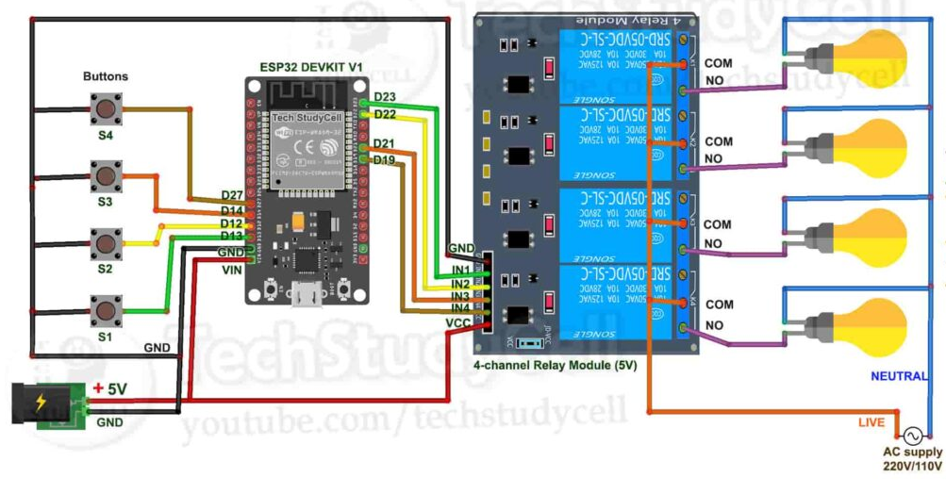
Fig.no 10 Circuit diagram of ESP32 With Relay module

Slide 19
Program ESP32 With Arduino IDE
/**********************************************************************************
* TITLE: ESP RainMaker + Manual Switch control 4 Relays using ESP32 (Real time feedback + no WiFi control)
* Preferences--> Aditional boards Manager URLs :
* http://arduino.esp8266.com/stable/package_esp8266com_index.json,https://raw.githubusercontent.com/espressif/arduino-esp32/gh-pages/package_esp32_index.json

Slide 20
Download Board ESP32 (2.0.3) :
* Download the libraries :
* N/A
**********************************************************************************/
#include "RMaker.h"
#include "WiFi.h"
#include "WiFiProv.h"
const char *service_name = "PROV_12345";
const char *pop = "1234567"

Slide 21
// define the Device Names
char deviceName_1[] = "Switch1";
char deviceName_2[] = "Switch2";
char deviceName_3[] = "Switch3";
char deviceName_4[] = "Switch4";

Slide 22
Working
Start by write the code on Arduino IDE for controlling ESP32 Microcontroller.
Now compile and upload the code in ESP32.
Connect this app with ESP 32 microcontroller with the help of QR code Which is generated through Arduino IDE. For this required Wi Fi connectivity between app and ESP32.
Now we connect all the components with the help of circuit diagram with ESP32 Microcontroller.
After this download the ESP rainmaker app in your mobile phone.
Download google home from play store/app store.

Slide 23
Connect this ESP rainmaker app with Google home app.
Then you can control your home appliances by using voice command and also by using user interface of google home app.
Now download the Amazon alexa app from app store/play store.
Connect amazon alexa app with ESP rainmaker app.
After this you have one another option to control your home appliances by using you voice command and also by using UI of amazon alexa app.
By using same steps you can prefer other option for controlling home appliances which is available in market.

Slide 24
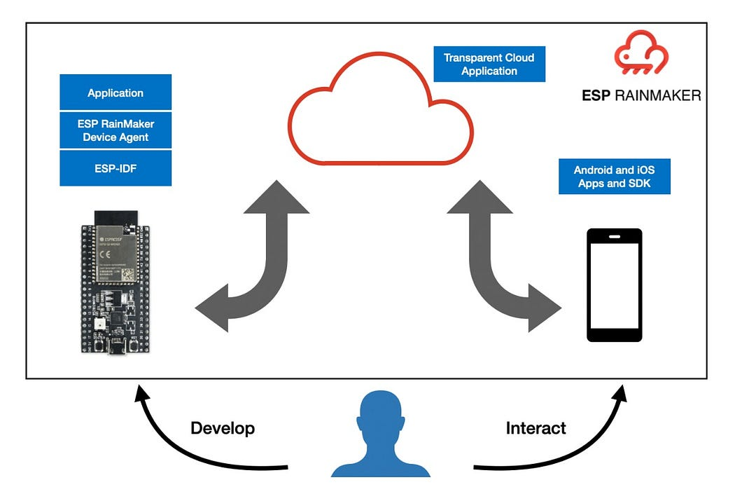
Flow Chart
Flow Chart of controlling ESP32 from mobile phone UI.

Slide 25
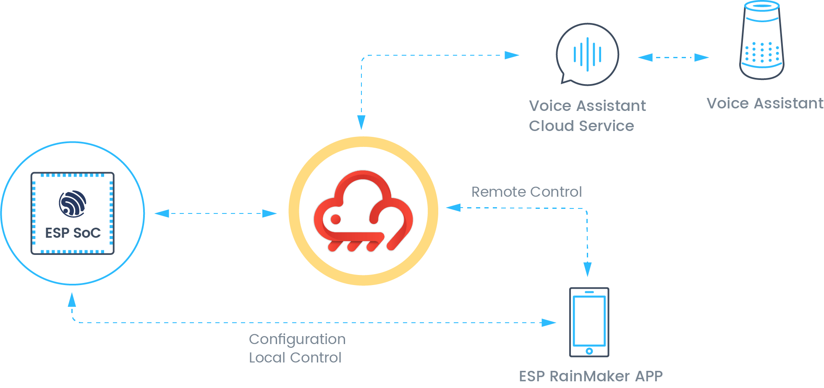
Flow Chart of controlling ESP32 from mobile phone voice command.

Slide 26
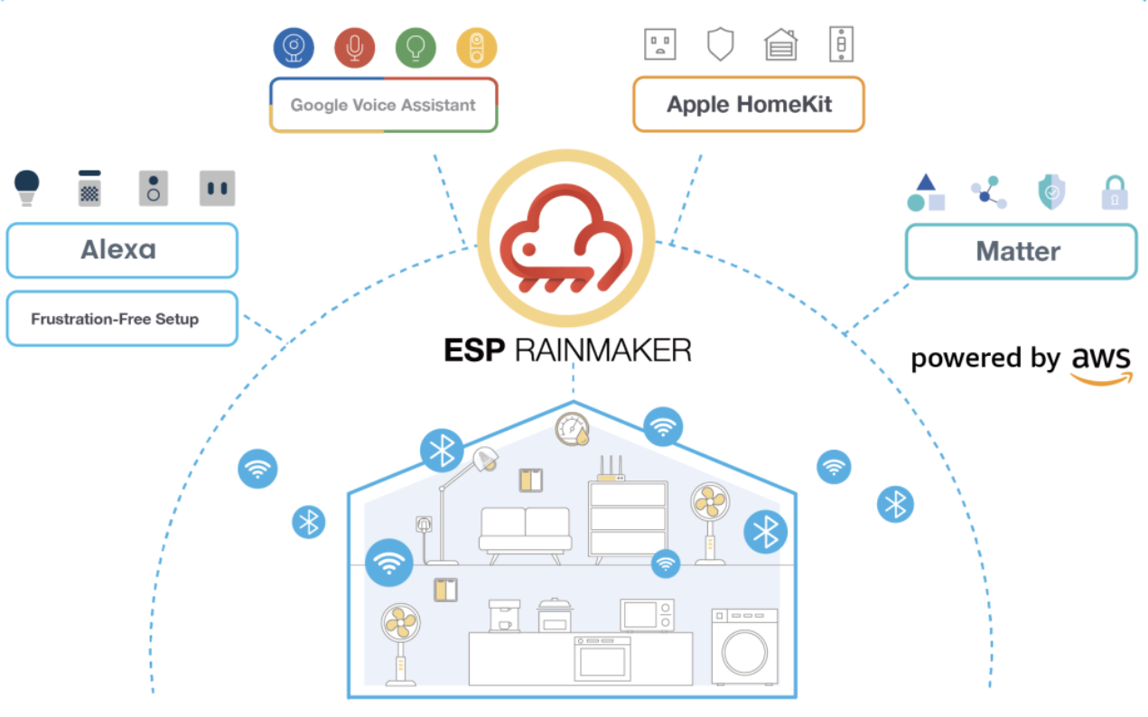
Complete Flow Chart of ESP Rainmaker

Slide 27
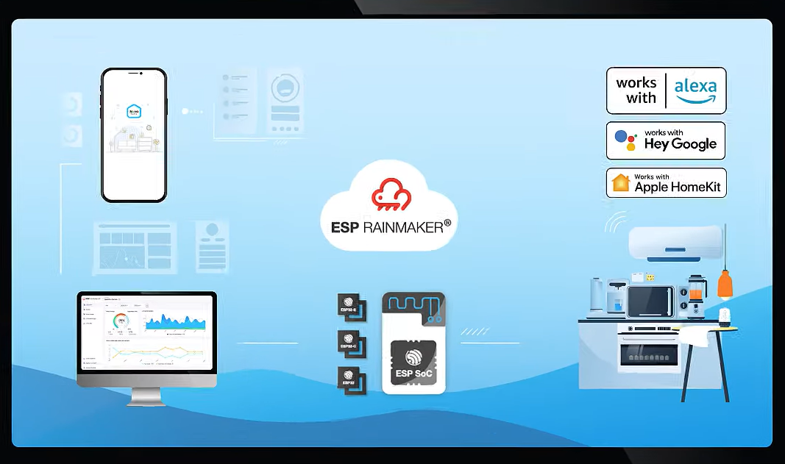
Service Platforms

Slide 28
Advantages
Error probability reduced Ease of access and low cost and power consumption
Can reduce human effort
Smarter processing and services
Can be implemented at any device and automated
Alert system is quick in case of an emergency
Eliminates the use of PC for automation
Helps old age people to control the remote devices
Simple interface

Slide 29
Disadvantages
Replacing humans is dangerous May take time and learning
Security concerns
Vulnerable to attacks Most of the times range is restricted
High dependency on sensor devices which makes the system vulnerable if sensor fails

Slide 30
Conclusion
In conclusion, the Home Automation System using IoT represents a paradigm shift in home management, offering users unprecedented control, efficiency, and security. This project serves as a testament to the transformative potential of IoT in shaping smarter and more connected living spaces.

Slide 31
Reference
Git Hub
Esp 32 Module-https://amzn.to/3ymRZcT
Relay Module 4 channel-https://amzn.to/3yxxPNN
Manual switches -https://www.amazon.in/dp/B08R5KNZWP/ref=sspa_dk_detail_2?pd_rd_i=B08R5KNZWP&pd_rd_w=Fb8EL&content-id=amzn1.sym.0fcdb56a-738b-4621-9da7-d47193883987&pf_rd_p=0fcdb56a-738b-4621-9da7-d47193883987&pf_rd_r=N8CGN9CNFDCX5EEDW9Q3&pd_rd_wg=jAMMX&pd_rd_r=218192bd-effe-4375-9b1b-c65107690419&s=industrial&sp_csd=d2lkZ2V0TmFtZT1zcF9kZXRhaWwy&th=1
LED Lights-https://www.amazon.in/Philips-0-5-Decomini-Multicolor-Pack/dp/B01BGP193Y/ref=pd_vtp_h_pd_vtp_h_d_sccl_4/261-1852555-4406809?pd_rd_w=qixxP&content-id=amzn1.sym.6c9a4279-ad42-4fd6-b9a9-3cd14ede34c9&pf_rd_p=6c9a4279-ad42-4fd6-b9a9-3cd14ede34c9&pf_rd_r=FF75H7WS7W8XDJ1YPJY3&pd_rd_wg=1jV5s&pd_rd_r=3141cd6a-3b04-474b-a92d-047bbb66aaf2&pd_rd_i=B01BGP193Y&psc=1

